Slide 1
Optimization of Li-ion battery design
Raghav Agarwal, Hirbod Akhavan, Kenton Cuddington

Slide 2
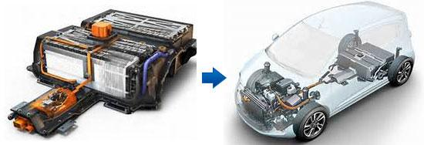
Motivation
Developments of alternate energy storage systems are being used for
Transportation use
Storing solar energy
Powering electronic gadgets such as mobile phones, laptops and tablets
This has been driven by a combination of
Environmental preservation
Fossil fuel price volatility
Energy security concerns

Slide 3
Motivation
Lithium-ion battery has emerged as a favored choice, but its energy density is still orders of magnitude lower than that fossil fuel
The main motivation for using this Li ion battery technology is the fact that lithium is the lightest and most electropositive metallic element, and therefore facilitates very high energy density
Battery design variable optimization can significantly affect battery capacity, discharge specific power, and discharge specific energy

Slide 4
Objective
The objective of this project is to
Maximize the energy density of the Lithium ion battery
Allows for delivering power over a longer period of time without recharging the cell.
Minimize the maximum temperature in the cell to increase expected life.
Will help prevent thermal runaway, combustion and overheating of the battery at high voltage, which are currently principal concerns of using li-ion cells in certain applications.
These are conflicting objectives since to increase energy density, thickness of electrode needs to be reduced while porosity needs to increase. For thermal, the opposite is needed.

Slide 5
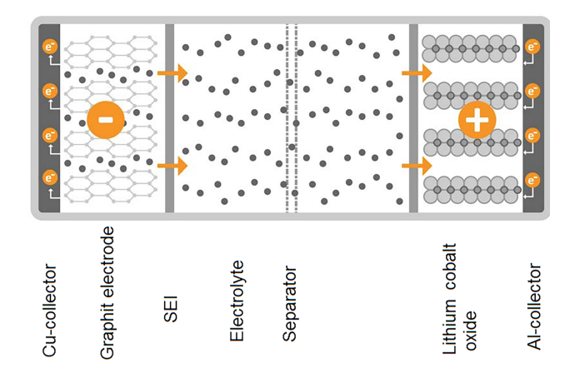
Structure of Li Ion Cell

Slide 6
Variables and Parameters
Variables:
X₁: anode thickness.
X₂: cathode thickness.
X₃: separator thickness.
X₄: anode porosity.
X₅: cathode porosity.
Parameters:
Q1 = 8 Heat generation in cathode W/m^3
Q2 = 10 Heat generation in anode W/m^3
Kc = 20 Separator layer thermal conductivity
K1 = 10 Cathode thermal conductivity
K2 = 5 Anode thermal conductivity
L1 = 5.1e-8 Cathode mean free path at 0% porosity
L2 = 3e-8 Anode mean free path at 0% porosity
R1 = 1e-8 Cathode particle size
R2 = 2e-9 Anode particle size
T_inf = 30 Coolant temperature in C
h = 0.009 Coolant convection coefficient

Slide 7
Parameters Continued
h_cell = 0.07 height of cell in m
C_0_anode = 22055 Concentration of anode in mol/m^3
F = 96487 Faraday's Constant in C/mol
rho_n = 2270 Density of anode in kg/m^3
rho_s = 900 Density of separator in kg/m^3
rho_p = 4140 Density of cathode in kg/m^3
rho_e = 1210 Density of electrolyte in kg/m^3
rho_ccn = 8700 Density of negative current collector Cu foil kg/m^3
rho_ccp = 2700 Density of positive current collector Al in foil kg/m^2
epsilon_s = 0.46 Porosity of Separator

Slide 8
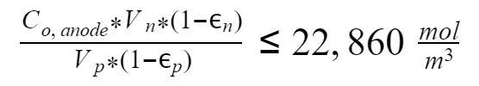




Constraints
Cathode Max Lithium Concentration [1]
Maximum operating temperature of the cell.
Anode and Cathode thicknesses need to stay within a range to permit li-ion cell usage [2]
Anode and Cathode porosity need to stay within a range to ensure proper functioning of li-ion cell [2]

Slide 9
Optimization Formulation and Assumptions
Assumptions:
CC layer has a zero thickness and infinite coefficient of thermal conductivity.
K₁ and K₂, the thermal conductivity of the anode and cathode, are not a function of X₁ and X₂.
The number of layers of anode and cathode, S, must be the same.
Layers of the battery are arranged as concentric circles
Only the entirety of the lithium initially in the anode will be the active lithium
There is initially no lithium in the cathode and any lithium initially in the electrolyte will remain in the electrolyte

Slide 10
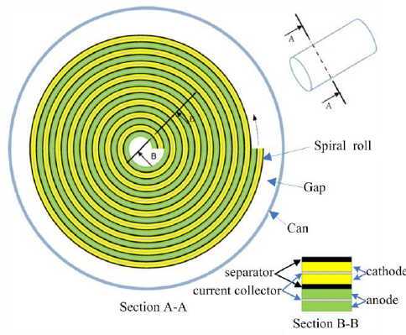

Formulation: Thermal Performance
Center pin modeled as insulated wall
T₀
Q̇1
Q̇1
Q̇2
Q̇2
T∞,h
X₁
C
X₂
X
T=T₁
This pattern is repeated S times

Slide 11
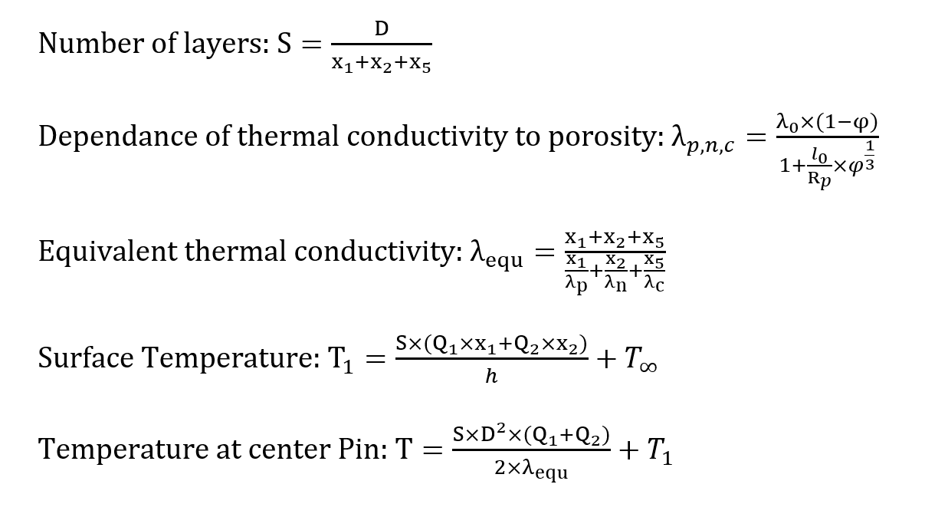
Formulation: Thermal Performance
Center pin modeled as insulated wall
T₀
Q̇1
Q̇1
Q̇2
Q̇2
T∞,h
X₁
C
X₂
X
T=T₁

Slide 12



Formulation: Energy Density
m = mass of an element transferred during electrolysis
n = valency of the element (Li = 1)
M = molar mass of the element
F = Faraday’s Constant (96,487 C/mol)
C = Concentration (in mol/m³)
V = Volume

Slide 13
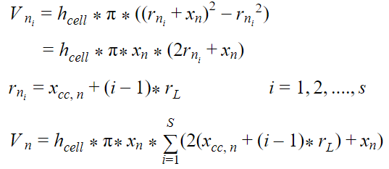

Formulation: Energy Density
= Volume of Anode in i^{th} Layer
= Inner Radius of Anode in i^{th} Layer
= Thickness of 1 Layer
Current Collector, N
Anode
Separator
Cathode
Current Collector, P

Slide 14
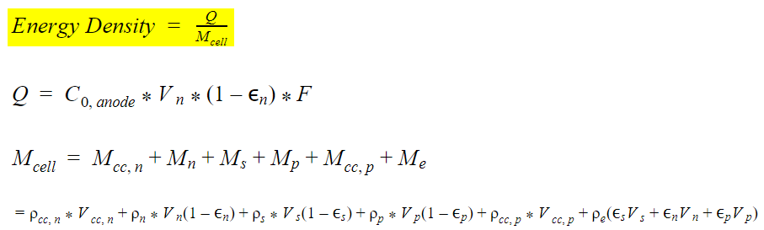
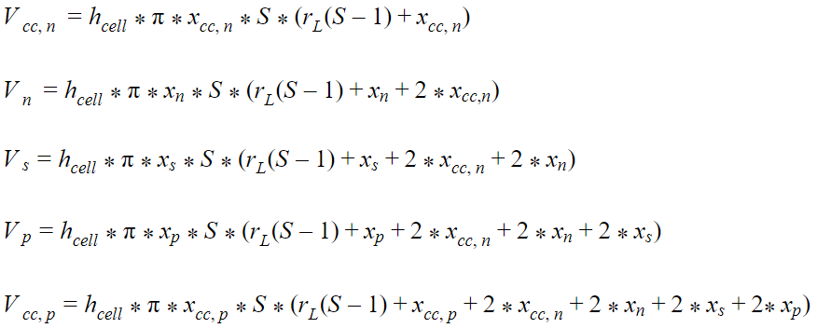
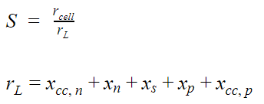
Formulation: Energy Density

Slide 15
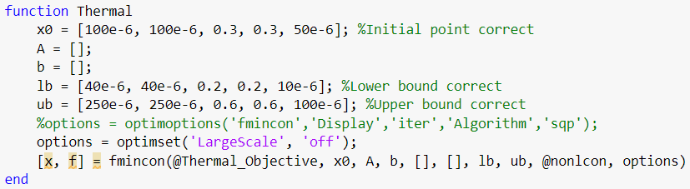
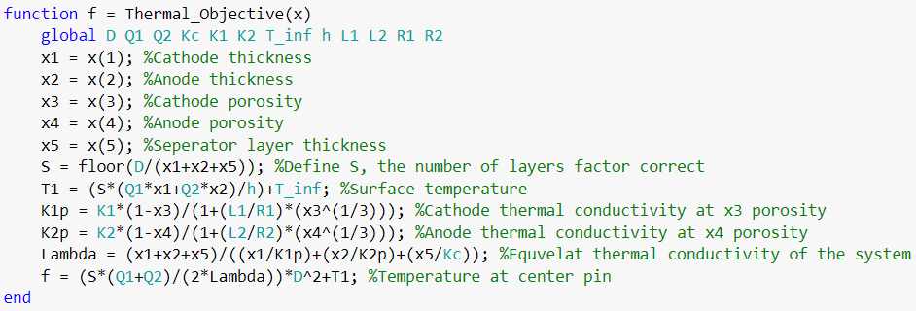
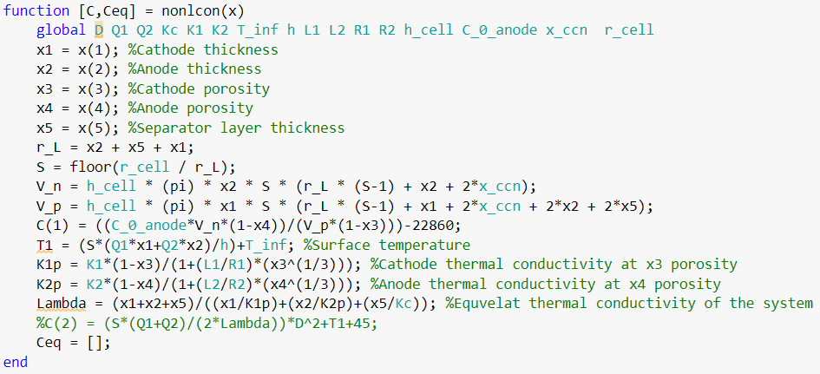
Single-Objective Thermal Optimization
Using fmincon:
Min Pin Temperature: 35.78 C
Anode Thickness:
60.65 um
Cathode Thickness:
89.85 um
Separator Thickness:
10 um
Anode Porosity:
41%
Cathode Porosity: 28.8%

Slide 16
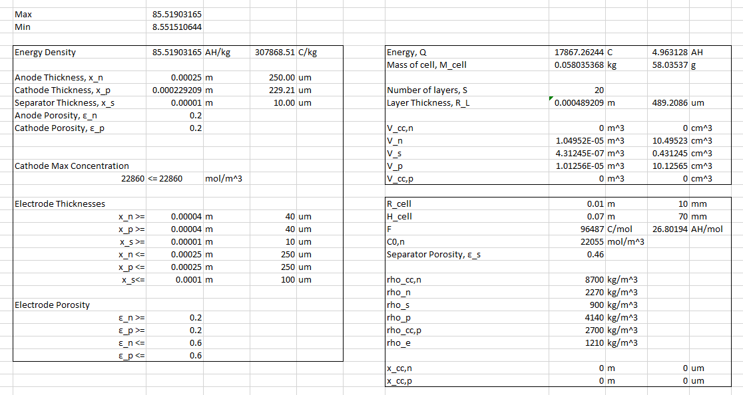
Single-Objective Energy Density Optimization
Max Energy Density: 85.519 AH/kg
Anode Thickness:
250 um
Cathode Thickness:
229.21 um
Separator Thickness:
10 um
Anode Porosity:
20%
Cathode Porosity:
20%

Slide 17
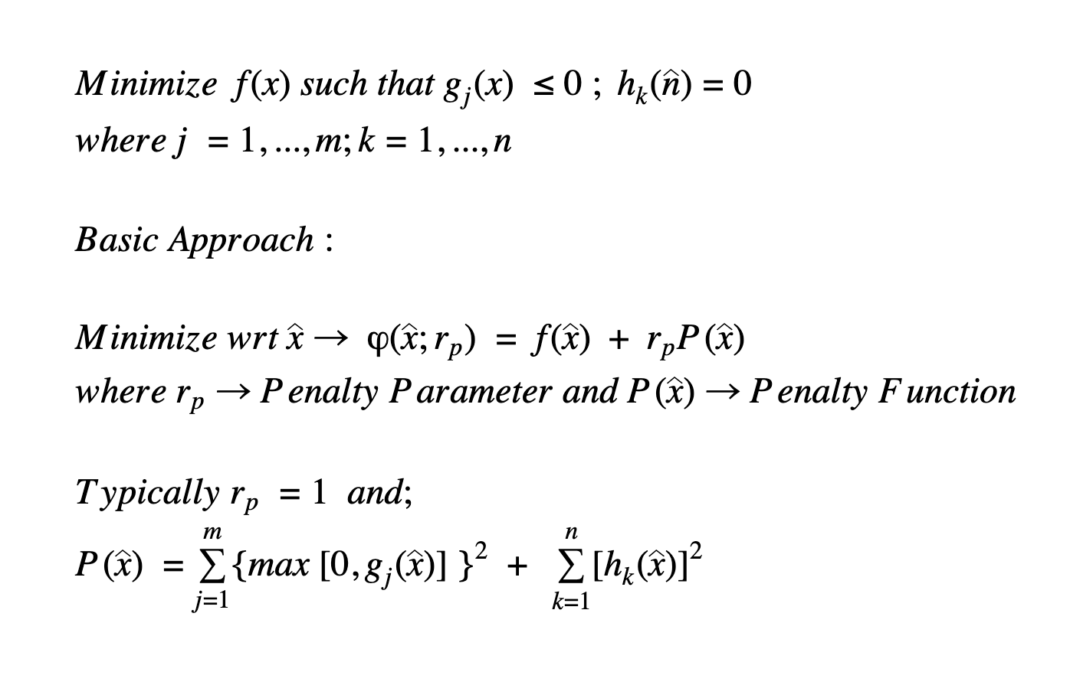
Single-Objective Energy Density Optimization : Penalty Method

Slide 18



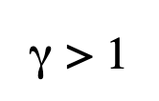
Penalty Method: Pseudo Code/Flowchart
Start
Given :
Converge
Yes
End
No

Slide 19
Energy Density Optimization: Results Obtained
Using Penalty Method :
Max Energy Density: 70.28 AH/kg
Anode Thickness: 100 um
Cathode Thickness: 100 um
Separator Thickness: 55 um
Anode Porosity: 30%
Cathode Porosity: 30%
Using fmincon :
Max Energy Density: 85.519 AH/kg
Anode Thickness: 229.2 um
Cathode Thickness: 250 um
Separator Thickness: 10 um
Anode Porosity: 20%
Cathode Porosity: 20%

Slide 20
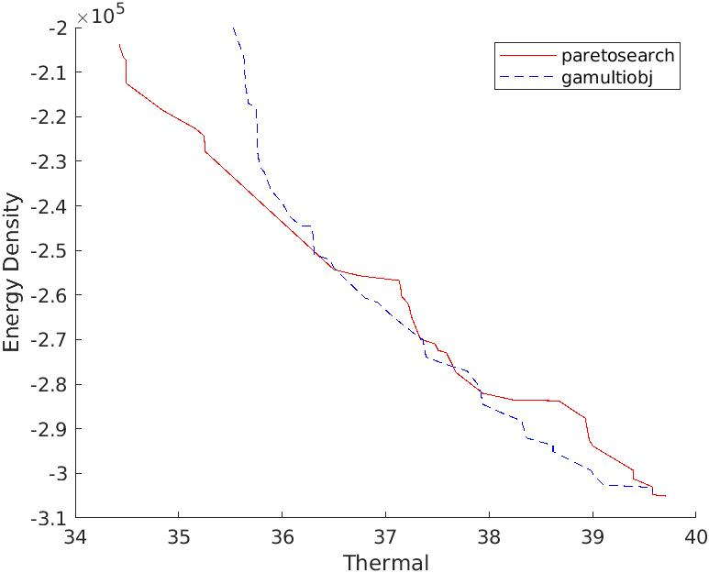
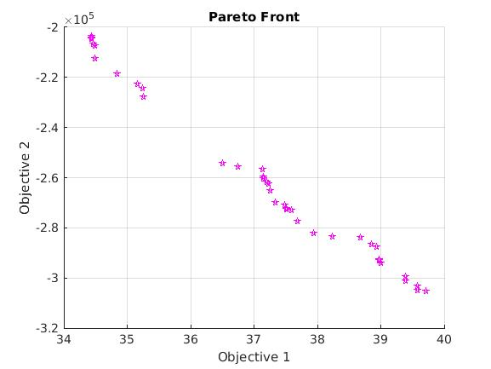
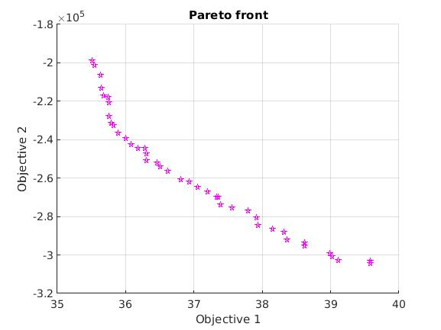
Bi-Objective Optimization
Pareto search
Generic Algorithm
Thermal less than 38 C degrees and energy density higher than 2.7e5 C/kg

Slide 21
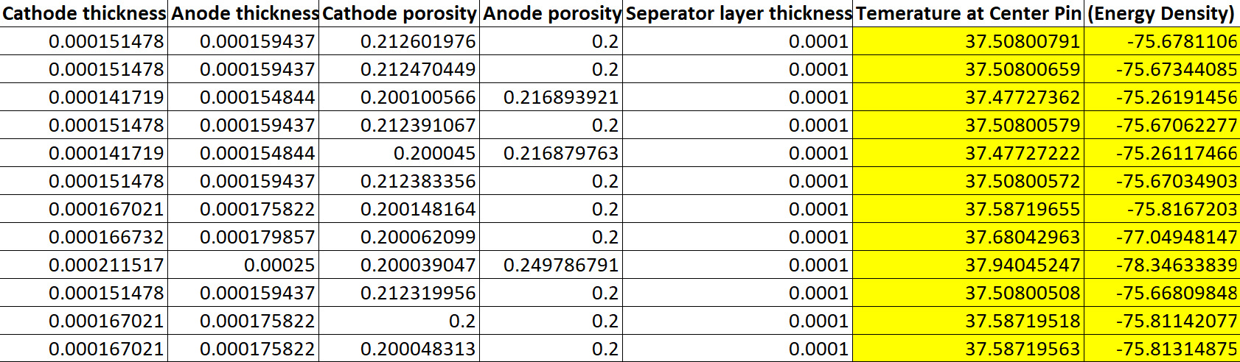
Bi-Objective Optimization

Slide 22
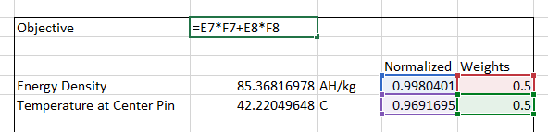
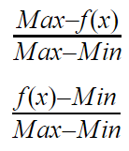
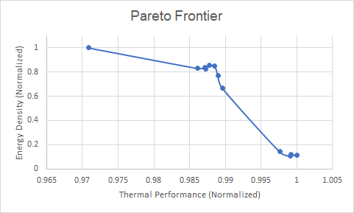
Bi-Objective Optimization
Energy Density Normalization
Temperature Normalization
Energy Density:
85.519 AH/kg
Temperature at Center Pin:
41.992 ℃

Slide 23
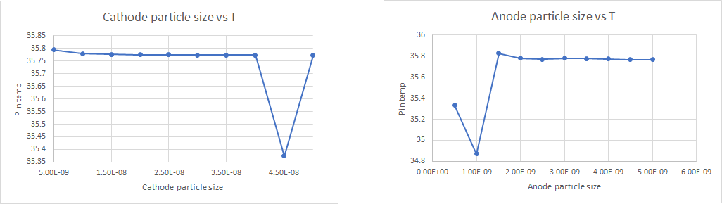
Parametric Study

Slide 24
Lessons Learned
Porosity needs to minimized as much as possible (solution was at the bounds)
Particle size can be a design variable in future work
Excel is very sensitive to starting points and is not good at global optimization
Fmincon optimizes the function with better accuracy than penalty method
Penalty method requires a lot of iterations and is time consuming

Slide 25
References
[1] Kim, J., Lee, D., Lee, J. et al. Optimization for maximum specific energy density of a lithium-ion battery using progressive quadratic response surface method and design of experiments. Sci Rep 10, 15586 (2020). https://doi.org/10.1038/s41598-020-72442-4
[2] Xue, N. et al. Optimization of a single lithium-ion battery cell with a gradient-based algorithm. J. Electrochem. Soc. https://doi.org/10.1149/2.036308jes (2013).
[3] Zhijia Du, D. L. Wood III, C. Daniel, S. Kalnaus, Jianlin Li.Understanding limiting factors in thick electrode performance as applied to high energy density Li-ion batteries. https://www.osti.gov/servlets/purl/1346648
[4] Appiah, W.A., Park, J., Song, S., Byun, S., Ryou, M.H., & Lee, Y.M. Design optimization of LiNi0.6Co0.2Mn0.2O2/graphite lithium-ion cells based on simulation and experimental data. J. Power Sources. 1:2–3. https://doi.org/10.1016/j.jpowsour.2016.04.052 (2016)

